Slide 1

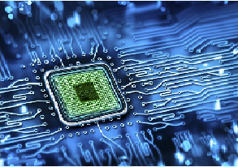
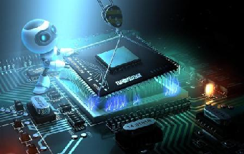

16CS402 - Embedded Systems
4th Year 1st Semester
CSE
Dr. V. VIJAYARAGHAVAN, M.E., Ph.D.,
Assistant Professor - ECE, VFSTR, Guntur, AP.

Slide 2

16CS402 - Embedded Systems
4th Year 1st Semester
CSE
Unit-1
Dr. V. VIJAYARAGHAVAN, M.E., Ph.D.,
Assistant Professor - ECE, VFSTR, Guntur, AP.

Slide 3
UNIT - I
Introduction to Embedded Systems
Definition, Applications of Embedded Systems
Embedded Hardware Units and Devices
Embedded Software
Design Metrics in ES, Challenges in ES design
Host and Target Machines Getting ES in to Target System
Dr. V.Vijayaraghavan, Assistant Professor-ECE, VFSTR, Guntur

Slide 4
Embedded Computing Platform Design
UNIT – I INTRODUCTION TO EMBEDDED SYSTEMS
Definition:
An embedded system is a system that has embedded software in a hardware and it is dedicated for either an application (or) specific part of an application but not it self intended to be a general purpose computer.
Ex:- Washing Machine, DVD Player, Digital Camera, Air Conditioner, Printer, Mobile phones, etc.,
An embedded system has three main components:
It has hardware.
It has application software.
It has Real Time Operating system (RTOS)
(The embedded software is also called ‘firmware’)
Dr. V.Vijayaraghavan, Assistant Professor-ECE, VFSTR, Guntur
Notes:
<number>
19/07/19
V.Vijayaraghavan, AP-ECE, AIT

Slide 5
Embedded Computing Platform Design
Definition……
Characteristics:
Real-time and Multi-rate operations,
Complex algorithms,
Complex GUIs and other user interfaces,
Dedicated functions.
Constraints:
Available system memory,
Available processor speed,
Limits power dissipation.
(Performance, Power, Size and Cost are other design constraints).
Dr. V.Vijayaraghavan, Assistant Professor-ECE, VFSTR, Guntur
Notes:
<number>
19/07/19
V.Vijayaraghavan, AP-ECE, AIT

Slide 6
Embedded Computing Platform Design
Definition……
EMBEDDED SYSTEM & GENERAL PURPOSE COMPUTER:
GENERAL PURPOSE COMPUTER | EMBEDDED SYSTEM
It is combination of generic hardware and a general purpose OS for executing a variety of applications. | It is combination of special purpose hardware and embedded OS for executing specific set of applications.
It contains general purpose operating system. | It may or may not contain operating system.
Applications are alterable by the user. | Applications are non-alterable by the user.
Performance is the key factor. | Application specific requirements are the key factors.
More Power Consumption. | Less Power Consumption.
Response Time is Not Critical. | Response Time is Critical for some applications.
Dr. V.Vijayaraghavan, Assistant Professor-ECE, VFSTR, Guntur
Notes:
<number>
19/07/19
V.Vijayaraghavan, AP-ECE, AIT

Slide 7
Embedded Computing Platform Design
Definition……
Categories of Embedded Systems:
Embedded systems are classified into four categories based on their performance and functional requirements:
Stand-alone Embedded Systems
Real-time Embedded Systems
Networked embedded systems
Mobile embedded systems.
Embedded Systems are classified into three types based on the performance of the microcontroller:
Small scale embedded systems
Medium scale embedded systems
Sophisticated embedded systems.
Dr. V.Vijayaraghavan, Assistant Professor-ECE, VFSTR, Guntur
Notes:
<number>
19/07/19
V.Vijayaraghavan, AP-ECE, AIT

Slide 8
Embedded Computing Platform Design
Categories:
i) Stand-alone Embedded Systems
Stand-alone systems take inputs, process them and produce the desired output.
The input can be electrical signals from transducers or commands from a human being. The output can be electrical signals to drive another system, an LED display or LCD display for displaying of information to the users.
Embedded systems used in process control, automobiles, consumer electronic items etc. fall into this category.
Ex: Digital Camera, Microwave Oven, CD Player, Air conditioner, TV etc.
Dr. V.Vijayaraghavan, Assistant Professor-ECE, VFSTR, Guntur
Notes:
<number>
19/07/19
V.Vijayaraghavan, AP-ECE, AIT

Slide 9
Embedded Computing Platform Design
Categories:
ii) Real-time Systems
Embedded systems in which some specific work has to be done in a specific time period are called real-time systems.
For example, consider a system that has to open a valve within 30 milliseconds when the humidity crosses a particular threshold. If the valve is not opened within 30 milliseconds, a catastrophe may occur. Such systems with strict deadlines are called hard real-time systems.
In some embedded systems, deadlines are imposed, but not adhering to them once in a while may not lead to a catastrophe. For example, you give a command to the DVD player from a remote control, and there is a delay of a few milliseconds in executing that command. But, this delay won’t lead to a serious implication. Such systems are called soft real-time systems.
Dr. V.Vijayaraghavan, Assistant Professor-ECE, VFSTR, Guntur
Notes:
<number>
19/07/19
V.Vijayaraghavan, AP-ECE, AIT

Slide 10
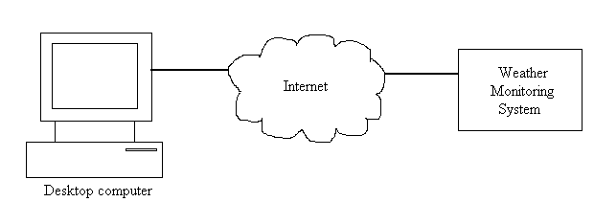
Embedded Computing Platform Design
Categories:
iii) Networked Information Appliances
Embedded systems that are provided with network interfaces and accessed by networks such as Local Area Network or the Internet are called networked information appliances.
TCP/IP (Transmission Control Protocol/Internet Protocol) protocol suite is used.
Figure shows a weather monitoring system connected to the Internet. TCP/IP protocol suite and HTTP web server software will be running on this system. Any computer connected to the Internet can access this system to obtain real-time weather information.
Dr. V.Vijayaraghavan, Assistant Professor-ECE, VFSTR, Guntur
Notes:
<number>
19/07/19
V.Vijayaraghavan, AP-ECE, AIT

Slide 11
Embedded Computing Platform Design
Categories:
iv) Mobile Devices
Mobile devices such as mobile phones, Personal Digital Assistants (PDAs), smart phones etc. are a special category of embedded systems. Though the PDAs do many general purpose tasks, they need to be designed just like the ‘conventional’ embedded systems.
Dr. V.Vijayaraghavan, Assistant Professor-ECE, VFSTR, Guntur
Notes:
<number>
19/07/19
V.Vijayaraghavan, AP-ECE, AIT

Slide 12
Embedded Computing Platform Design
Based on the Performance of the Microcontroller
i) Small Scale Embedded Systems
These types of embedded systems are designed with a single 8 or 16-bit microcontroller. For developing embedded software, the main programming tools are an editor, assembler, cross assembler and integrated development environment (IDE).
ii) Medium Scale Embedded Systems
These types of embedded systems design with a single or 16 or 32 bit microcontroller, RISCs or DSPs. For developing embedded software, the main programming tools are C, C++, JAVA, Visual C++, RTOS, debugger, source code engineering tool, simulator and IDE.
iii) Sophisticated Embedded Systems
These types of embedded systems have enormous hardware and software complexities, that may need ASIPs, IPs, PLAs, scalable or configurable processors.
Dr. V.Vijayaraghavan, Assistant Professor-ECE, VFSTR, Guntur
Notes:
<number>
19/07/19
V.Vijayaraghavan, AP-ECE, AIT

Slide 13
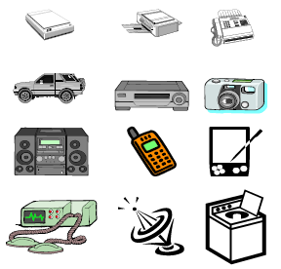
Embedded Computing Platform Design
UNIT – I INTRODUCTION TO EMBEDDED SYSTEMS
Applications:
Embedded systems are used in different applications like automobiles, telecommunications, smart cards, missiles, satellites, computer networking and digital consumer electronics.
Embedded Systems in Automobiles and in telecommunications
Motor and cruise control system
Body or Engine safety
Entertainment and multimedia in car
E-Com and Mobile access
Robotics in assembly line
Wireless communication
Mobile computing and networking
Dr. V.Vijayaraghavan, Assistant Professor-ECE, VFSTR, Guntur
Notes:
<number>
19/07/19
V.Vijayaraghavan, AP-ECE, AIT

Slide 14
Embedded Computing Platform Design
Applications…..
Embedded Systems in Smart Cards, Missiles and Satellites
Security systems
Telephone and banking
Defence and aerospace
Communication
Embedded Systems in Peripherals & Computer Networking
Displays and Monitors
Networking Systems
Image Processing
Network cards and printers
Embedded Systems in Consumer Electronics
Digital Cameras
Set top Boxes
High Definition TVs
DVDs
Dr. V.Vijayaraghavan, Assistant Professor-ECE, VFSTR, Guntur
Notes:
<number>
19/07/19
V.Vijayaraghavan, AP-ECE, AIT

Slide 15
Applications…..
Consumer Appliances
Digital camera, digital diary, DVD player, electronic toys, microwave oven, remote controls for TV and air conditioner, VCD player, video game consoles, video recorders etc.
Ex: Digital diary: Casio digital diaries are electronic organizers capable of storing hundreds or thousands of memo, address, and schedule records.
Features of Digital diary:
Telephone directory
Schedule keeper
Memo function
To do list
World time
Secret memory area
Alarm
Metric & Currency conversion function
Dr. V.Vijayaraghavan, Assistant Professor-ECE, VFSTR, Guntur
Notes:
<number>
19/07/19
V.Vijayaraghavan, AP-ECE, AIT

Slide 16
Embedded Computing Platform Design
Applications…..
ii) Office Automation
The office automation products using embedded systems are copying machine, fax machine, key telephone, modem, printer, scanner etc.
Ex: Modem :
A modem (modulator-demodulator) is a device that modulates an analog carrier signal to encode digital information, and also demodulates such a carrier signal to decode the transmitted information. The goal is to produce a signal that can be transmitted easily and decoded to reproduce the original digital data.
Modems are generally classified by the amount of data they can send in a given unit of time, usually expressed in bits per second (bit/s, or bps).
Dr. V.Vijayaraghavan, Assistant Professor-ECE, VFSTR, Guntur
Notes:
<number>
19/07/19
V.Vijayaraghavan, AP-ECE, AIT

Slide 17
Applications…..
iii) Industrial Automation
The embedded systems for industrial use are designed to carry out specific tasks such as monitoring the temperature, pressure, humidity, voltage, current etc.,
Thirty years earlier, the Volkswagen 1600 used a microprocessor to control its fuel injection, making it the first embedded system in the auto industry.
Ex: Industrial Robot:
An industrial robot is as an automatically controlled, reprogrammable, multipurpose manipulator programmable in three or more axes. Typical applications of robots include welding, painting, assembly, pick and place, product inspection, and testing; all accomplished with high speed, and precision.
Embedded Computing Platform Design
Dr. V.Vijayaraghavan, Assistant Professor-ECE, VFSTR, Guntur
Notes:
<number>
19/07/19
V.Vijayaraghavan, AP-ECE, AIT

Slide 18
Applications…..
iv) Medical Electronics
Almost every medical equipment in the hospital is an embedded system. These equipments include diagnostic aids such as ECG, EEG, blood pressure measuring devices, X-ray scanners; equipment used in blood analysis, radiation, endoscopy etc.
Electrocardiogram (ECG) is used to measure the rate and regularity of heartbeats as well as the size and position of the chambers, the presence of any damage to the heart, and the effects of drugs or devices used to regulate the heart (such as a pacemaker).
Electroencephalography (EEG) is the recording of electrical activity along the scalp. EEG measures voltage fluctuations resulting from ionic current flows within the neurons of the brain.
Embedded Computing Platform Design
Dr. V.Vijayaraghavan, Assistant Professor-ECE, VFSTR, Guntur
Notes:
<number>
19/07/19
V.Vijayaraghavan, AP-ECE, AIT

Slide 19
Applications…..
v) Computer Networking
Bridges, routers, Integrated Services Digital Networks (ISDN), Asynchronous Transfer Mode (ATM), X.25 and frame relay switches are embedded systems which implement the necessary data communication protocols.
vi) Tele Communications
ISDN phones, terminal adapters, web cameras, packet assembler/disassembler are embedded systems.
vii) Wireless Technologies
The mobile phone is one of the marvels of the last decade of the 20th century. It is a very powerful embedded system that provides voice communication while we are on the move.
The Personal Digital Assistants and the palmtops can now be used to access multimedia services over the Internet.
Embedded Computing Platform Design
Dr. V.Vijayaraghavan, Assistant Professor-ECE, VFSTR, Guntur
Notes:
<number>
19/07/19
V.Vijayaraghavan, AP-ECE, AIT

Slide 20
Applications…..
viii) Instrumentation
Testing and measurement are the fundamental requirements in all scientific and engineering activities. The measuring equipment we use in laboratories to measure parameters such as weight, temperature, pressure, humidity, voltage, current etc are all embedded systems. Test equipment such as oscilloscope, spectrum analyzer, logic analyzer, protocol analyzer, radio communication test set etc. are embedded systems built around powerful processors.
ix) Security
Security of persons and information has always been a major issue. We need to protect our homes and offices; and also the information we transmit and store. Developing embedded systems for security applications is one of the most lucrative business nowadays.
Embedded Computing Platform Design
Dr. V.Vijayaraghavan, Assistant Professor-ECE, VFSTR, Guntur
Notes:
<number>
19/07/19
V.Vijayaraghavan, AP-ECE, AIT

Slide 21
Applications…..
ix) Security…
Security devices at homes, offices, airports etc. for authentication and verification are embedded systems. Encryption devices are used to encrypt the data/voice being transmitted on communication links such as telephone lines. Biometric systems using fingerprints and face recognition are now being extensively used for user authentication in banking applications as well as for access control in high security buildings.
Home security devices:
Closed-circuit TV
Door and/or window contacts
Glass break detector
Motion detector
Wireless panic button
Monitored fire detection system
Embedded Computing Platform Design
Dr. V.Vijayaraghavan, Assistant Professor-ECE, VFSTR, Guntur
Notes:
<number>
19/07/19
V.Vijayaraghavan, AP-ECE, AIT

Slide 22
Applications…..
x) Finance
Financial dealing through cash and cheques are now slowly paving way for transactions using smart cards and ATM (Automatic Teller Machine or Any Time Money) machines.
Credit Card:
A credit card is a small plastic card issued to users as a system of payment. It allows its holder to buy goods and services based on the holder's promise to pay for these goods and services.
Smart Card:
A smart card contain volatile memory and microprocessor components. Smart cards can provide identification, authentication, data storage and application processing.
A single contact/contactless smart card can be programmed with multiple banking credentials, medical entitlement, driver’s license/public transport entitlement, loyalty programs and club memberships, etc.
Embedded Computing Platform Design
Dr. V.Vijayaraghavan, Assistant Professor-ECE, VFSTR, Guntur
Notes:
<number>
19/07/19
V.Vijayaraghavan, AP-ECE, AIT

Slide 23
Applications…..
S.No | Embedded System | Application
1 | Home Appliances | Dishwasher, washing machine, microwave oven, set-top box, security system, DVD, answering machine, garden sprinkler systems etc..
2 | Office Automation | Fax, copy machine, smart phone system, modern, scanner, printers.
3 | Security | Face recognition, finger recognition, eye recognition, building security system , airport security system, alarm system.
4 | Academia | Smart board, smart room, OCR, calculator, smart cord.
5 | Instrumentation | Signal generator, signal processor, power supplier, Process instrumentation,
6 | Telecommunication | Router, hub, cellular phone, IP phone, web camera
7 | Automobile | Fuel injection controller, anti-locking brake system, air bag system, GPS, cruise control.

Slide 24
Applications…..
S.No | Embedded System | Application
8 | Entertainment | MP3, video game, Mind Storm, smart toy.
9 | Aerospace | Navigation system, automatic landing system, flight attitude controller, space explorer, space robotics.
10 | Industrial automation | Assembly line, data collection system, monitoring systems on pressure, voltage, current, temperature, hazard detecting system, industrial robot.
11 | Personal | PDA, iPhone, palmtop, data organizer.
12 | Medical | CT scanner, ECG , EEG , EMG ,MRI, Glucose monitor, blood pressure monitor, medical diagnostic device.
13 | Banking & Finance | ATM, smart vendor machine, cash register ,Share market
14 | Miscellaneous: | Elevators, tread mill, smart card, security door etc.

Slide 25
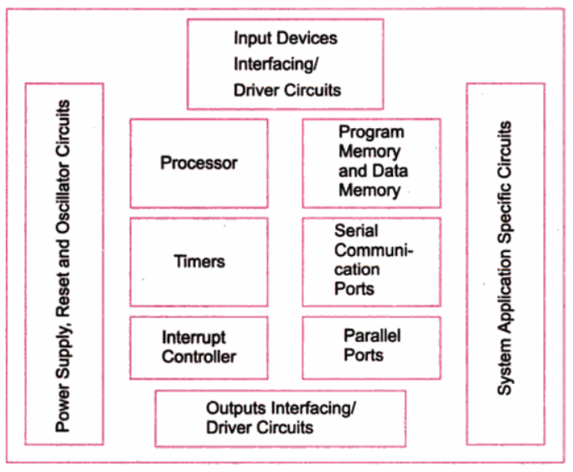
UNIT – I INTRODUCTION TO EMBEDDED SYSTEMS
Embedded Computing Platform Design
Embedded Hardware Units and Devices:
Every embedded system consists of custom-built hardware.
Dr. V.Vijayaraghavan, Assistant Professor-ECE, VFSTR, Guntur
Notes:
<number>
19/07/19
V.Vijayaraghavan, AP-ECE, AIT

Slide 26
Embedded Computing Platform Design
Embedded Hardware Units and Devices…..
1. Processor:
Processor has two essential units
Program Flow and data path Control Unit (CU) - includes a fetch unit for fetching instructions from the memory.
Execution Unit (EU) - includes circuits for arithmetic and logical unit (ALU), and for instructions for a program control task, data transfer instructions, halt, interrupt, or jump to another set of instructions or call to another routine or sleep or reset.
Embedded System Processor can be
General purpose microprocessor
Microprocessor - Intel 80x86, Sparc, or Motorola 68HCxxx.
Embedded general purpose processor - Intel Xscale for PDAs.
Application Specific Instruction-Set Processor (ASIP)
Microcontroller - Intel MCS51, Philips 51XA, or Motorola 68HC11.
DSP or Media processor or Network processor or IO processor.
Application Specific System Processor (ASSP)
Set top box processor or mpeg video-processor or mobile application processor.
Dr. V.Vijayaraghavan, Assistant Professor-ECE, VFSTR, Guntur
Notes:
<number>
19/07/19
V.Vijayaraghavan, AP-ECE, AIT

Slide 27
Embedded Computing Platform Design
Embedded Hardware Units and Devices…..
2. Power Source:
Most systems have a power supply of own. NICs and Graphic accelerators are do not have their own power supply and connect to processor power-supply lines.
Operated Power ranges
5V ±0.25V
3.3V ±0.3V
2V ±0.2V
1.5V ±0.2V
Charge pump concept used in a system of little power needs, for examples, in the mouse or contact-less smart card.
charge pump consists of a diode in the series followed by a charging capacitor used to accumulate charge from bus signals.
Dr. V.Vijayaraghavan, Assistant Professor-ECE, VFSTR, Guntur
Notes:
<number>
19/07/19
V.Vijayaraghavan, AP-ECE, AIT

Slide 28
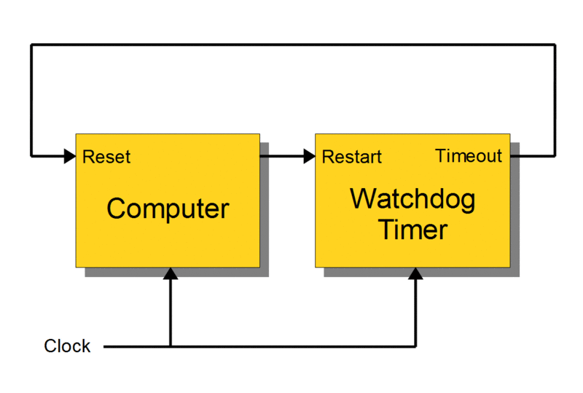
Embedded Computing Platform Design
Embedded Hardware Units and Devices…..
3. Clock Oscillator Circuit and Clocking Unit:
The Clock controls the time for executing an instruction.
The Clock is an important unit of a system. A processor needs a clock oscillator circuit.
The clock controls the various clocking requirements of the CPU, of the system timers and the CPU machine cycles.
4. Reset Circuit:
Reset on Power-up
External and Internal Reset circuit
Reset on Timeout of Watchdog timer.
Dr. V.Vijayaraghavan, Assistant Professor-ECE, VFSTR, Guntur
Notes:
<number>
19/07/19
V.Vijayaraghavan, AP-ECE, AIT

Slide 29
Embedded Computing Platform Design
Embedded Hardware Units and Devices…..
5. System timer and Real Time Clock (RTC):
A timer circuit suitably configured as the system-clock, which ticks and generates system interrupts periodically.
A timer circuit suitably configured as real-time clock (RTC). Used by schedulers, time and date of the system and for real-time programming.
6. Interrupt Handler:
Interrupt Handling element for the external port interrupts, IO interrupts, timer and RTC interrupts, software interrupts and exceptions.
System may prioritize the sources and service accordingly.
Some sources are non-maskable.
Dr. V.Vijayaraghavan, Assistant Professor-ECE, VFSTR, Guntur
Notes:
<number>
19/07/19
V.Vijayaraghavan, AP-ECE, AIT

Slide 30
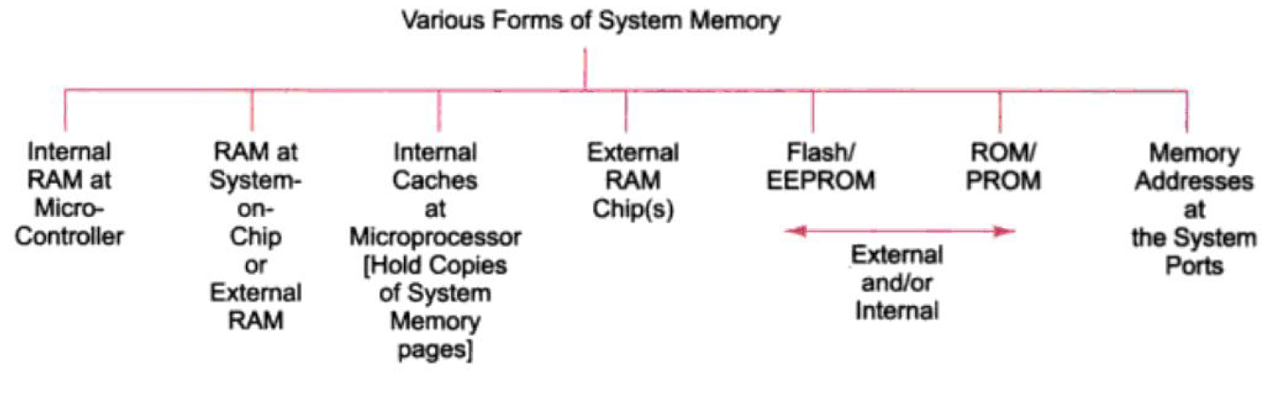
Embedded Computing Platform Design
Embedded Hardware Units and Devices…..
7. Memory:
In a system, there are various types of memories. They are as follows:
Internal RAM of 256 or 512 bytes for registers, temporary data stack.
Internal ROM/PROM/EEPROM for about 4 KB to 16 KB of program.
External RAM for the temporary data and stack or Internal caches.
Internal flash.
Memory sticks.
External ROM or PROM for embedding software.
RAM Memory buffers at ports.
Caches (in superscalar microprocessors).
Dr. V.Vijayaraghavan, Assistant Professor-ECE, VFSTR, Guntur
Notes:
<number>
19/07/19
V.Vijayaraghavan, AP-ECE, AIT

Slide 31
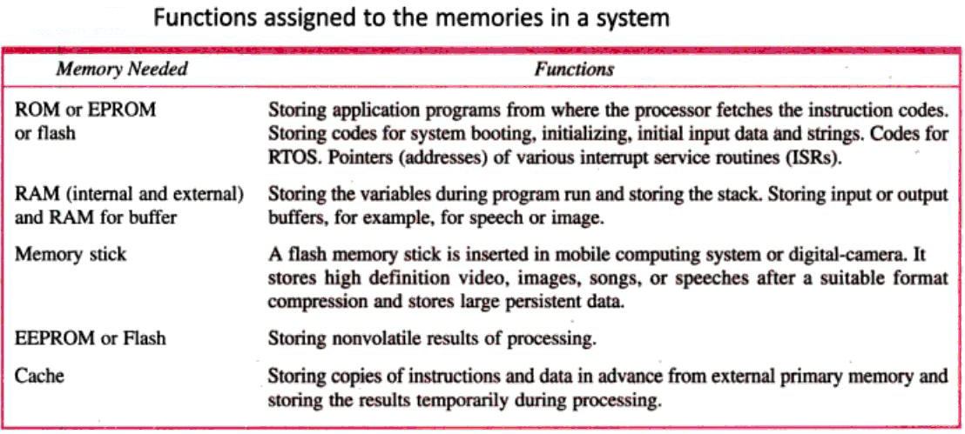
Embedded Computing Platform Design
Embedded Hardware Units and Devices…..
7. Memory……
Dr. V.Vijayaraghavan, Assistant Professor-ECE, VFSTR, Guntur
Notes:
<number>
19/07/19
V.Vijayaraghavan, AP-ECE, AIT

Slide 32
Embedded Computing Platform Design
Embedded Hardware Units and Devices…..
7. Memory…… Memory Comparison Table
Type | Volatile? | Writeable? | Erase Size | Max Erase Cycles | Cost (per Byte) | Speed
SRAM | Yes | Yes | Byte | Unlimited | Expensive | Fast
DRAM | Yes | Yes | Byte | Unlimited | Moderate | Moderate
Masked ROM | No | No | n/a | n/a | Inexpensive | Fast
PROM | No | Once | n/a | n/a | Moderate | Fast
EPROM | No | Yes, | Entire Chip | Limited | Moderate | Fast
EEPROM | No | Yes | Byte | Limited | Expensive | Fast to read, slow to erase/write
Flash | No | Yes | Sector | Limited | Moderate | Fast to read, slow to erase/write
NVRAM | No | Yes | Byte | Unlimited | Expensive (SRAM + battery) | Fast
Dr. V.Vijayaraghavan, Assistant Professor-ECE, VFSTR, Guntur
Notes:
<number>
19/07/19
V.Vijayaraghavan, AP-ECE, AIT

Slide 33
Embedded Computing Platform Design
Embedded Hardware Units and Devices…..
8. Input/Output Devices
Function Keypad & Touchscreen - to input data and/or commands.
Light Emitting Diodes (LEDs) - status display or indications of visual alarms for such events as power supply failure.
Liquid Crystal Displays (LCDs) - to display the status information.
Microphone and speakers - Microphone converts the acoustic energy into a voltage signal. The speakers convert the electrical signal back into acoustic waves.
Video camera and monitor - The real life image or scenery is converted into electrical signal using a video camera. The electrical signal is converted back to the image on a monitor.
Sensors and Transducers - to convert real life information into equivalent electrical signals.
Temperature sensors, Light sensors, Accelerometer, Pressure sensors
ADC – Single or Multi channel and DAC.
Modem, Bluetooth, 802.11, IrDA….
Dr. V.Vijayaraghavan, Assistant Professor-ECE, VFSTR, Guntur
Notes:
<number>
19/07/19
V.Vijayaraghavan, AP-ECE, AIT

Slide 34
Embedded Computing Platform Design
Embedded Hardware Units and Devices…..
9. Linking Embedded System Hardware
Linking and interfacing circuit for the Buses by using the appropriate multiplexers, and decoders, demultiplexers Interface the various system units.
Communication Driver: Network Ethernet or serial driver to communicate with host embedded system expansion facility.
Serial Buses (Example): UART (512 kbaud/s), Serial Port (230 kbps), 1-wire CAN (33 kbps), Fault tolerant CAN (110 kbps), Industrial I2C (100kbps), SPI (100 kbps), MicroWire (300 kbps).
Parallel Buses (Example): PCI, PCI-X
SCSI (Small Computer System Interface) parallel (40 Mbps), Fast SCSI (80 Mbps), Ultra SCSI-3 (160 Mbps), FireWire/IEEE 1394 (400 Mbps), High Speed USB 2.0 (480 Mbps).
Dr. V.Vijayaraghavan, Assistant Professor-ECE, VFSTR, Guntur
Notes:
<number>
19/07/19
V.Vijayaraghavan, AP-ECE, AIT

Slide 35
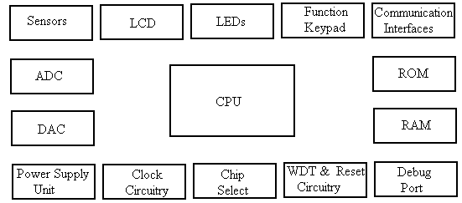
Hardware Architecture:
The various building block of embedded system hardware are shown in Fig.
V.Vijayaraghavan, Assistant Professor-ECE, VFSTR, Guntur
Notes:
<number>
19/07/19
V.Vijayaraghavan, AP-ECE, AIT

Slide 36
UNIT – I INTRODUCTION TO EMBEDDED SYSTEMS
Embedded Computing Platform Design
Embedded Software:
The Software is like a brain of the embedded system.
1. Final Machine Implementable Software for a System:
An Embedded system processor executes software that is specific to a given application of that system.
The instruction codes and data in the final phase are placed in the ROM or Flash memory. This is also called ROM image.
Bytes at each address defined for creating the ROM image. By changing this image, the same hardware platform work differently and can be used for entirely different applications or for new upgrades of the same system.
Hardware elements between the distinct systems can be identical but it is the software that makes a system unique and distinct from the other.
ROM image may alternatively be compressed software (for example, the zip format) and data (for example, the pictures in jpg or gif format) along with the software required for decompression algorithm.
Dr. V.Vijayaraghavan, Assistant Professor-ECE, VFSTR, Guntur
Notes:
<number>
19/07/19
V.Vijayaraghavan, AP-ECE, AIT

Slide 37
Embedded Computing Platform Design
Embedded Hardware Units and Devices…..
System ROM memory embedding the software, RTOS, data, and vector addresses
Dr. V.Vijayaraghavan, Assistant Professor-ECE, VFSTR, Guntur
Notes:
<number>
19/07/19
V.Vijayaraghavan, AP-ECE, AIT

Slide 38
Embedded Computing Platform Design
Embedded Hardware Units and Devices…..
2. Coding of Software in Machine Codes:
Programmer defines the addresses and the corresponding bytes or bits at each address.
Used in configuring some specific physical device or subsystem like transceiver, the machine code- based coding is used.
3. Software in Processor Specific Assembly Language:
Needed for Invoking Processor Specific Instructions, Requires understanding of the processor and instruction set.
A program or a small specific part coded in the assembly language using an Assembler (software used for developing codes in assembly).
It is extremely useful for configuring physical devices like Ports, Line display, ADC, DAC…etc.
To make all the codes in assembly is very time consuming.
Full coding in assembly may be done for simple small scale systems.
Dr. V.Vijayaraghavan, Assistant Professor-ECE, VFSTR, Guntur
Notes:
<number>
19/07/19
V.Vijayaraghavan, AP-ECE, AIT

Slide 39
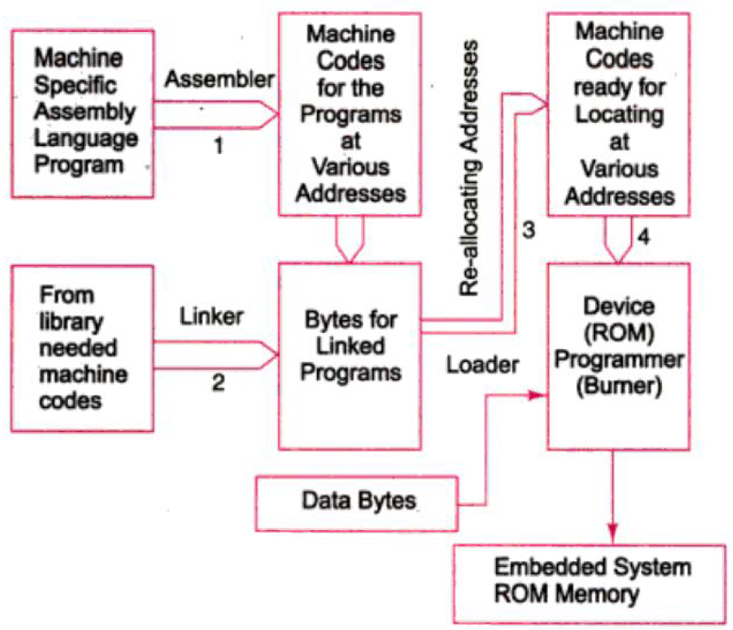
Embedded Hardware Units and Devices…..
3. Software in Processor Specific Assembly Language…
The steps followed when using assembly language before finally burned at the ROM
Embedded Computing Platform Design
‘Assembler’- Translates ALP to Machine codes.
‘Linker’ – Link the codes with the other codes. The linked file in binary for run is known as exe file.
‘Loader’ – Relocating the codes after finding the physical memory addresses available.
‘Locator’ – Locating these codes as a ROM image. It locates IO tasks and hardware device drivers codes at fixed addresses. (hex file)
‘Device Programmer’ – Takes ROM image and burns into PROM or Flash.
Conversion Process of Assembly to ROM image
Dr. V.Vijayaraghavan, Assistant Professor-ECE, VFSTR, Guntur
Notes:
<number>
19/07/19
V.Vijayaraghavan, AP-ECE, AIT

Slide 40
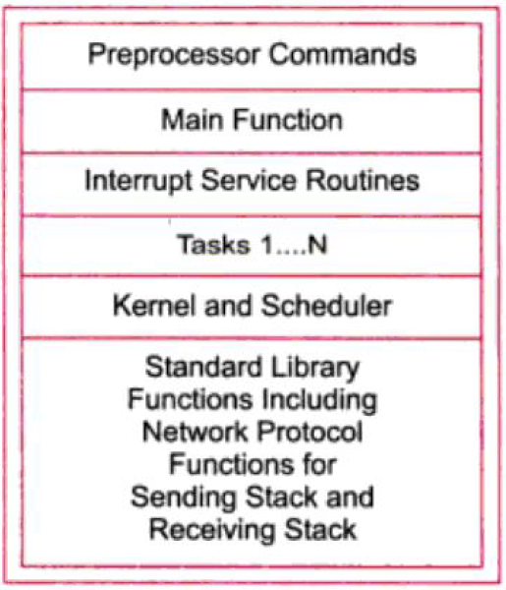
Embedded Computing Platform Design
Embedded Hardware Units and Devices…..
4. Software in High Level Language:
Coding in assembly is very time consuming, so software is developed in high level languages like C or C++ or Visual C++ or Java.
Figure shows different programming layers in a typical embedded C software.
Processor Commands,
Main Function,
Interrupt Service Routines,
Multiple Tasks (task functions),
Kernel and Scheduler,
Standard Library Functions, Protocol handling and Stack functions.
Dr. V.Vijayaraghavan, Assistant Professor-ECE, VFSTR, Guntur
Notes:
<number>
19/07/19
V.Vijayaraghavan, AP-ECE, AIT

Slide 41
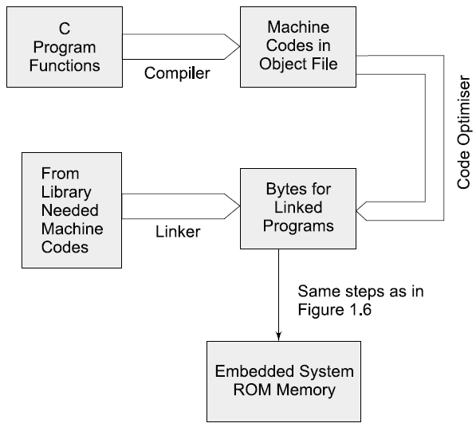
Embedded Hardware Units and Devices…..
4. Software in High Level Language…
The steps followed when using high level language before finally burned at the ROM
Embedded Computing Platform Design
‘Compiler’ – Generates the object codes. It assembles the code according to the processor instruction set and other specifications.
‘Code Optimizer’ – Optimizes the codes before linking.
‘Linker’ – Link the codes with the other codes. The linked file in binary for run is known as exe file.
‘Loader’ – Relocating the codes after finding the physical memory addresses available.
The file for ROM image is created for the targeted hardware.
Conversion Process of C program to ROM image
Dr. V.Vijayaraghavan, Assistant Professor-ECE, VFSTR, Guntur
Notes:
<number>
19/07/19
V.Vijayaraghavan, AP-ECE, AIT

Slide 42
Embedded Computing Platform Design
Embedded Hardware Units and Devices…..
5. Program Models for Software Designing:
The program design task is simplified if a program is modeled.
The different models that are employed during the design process of embedded software are as follows
Sequential Programming Model
Object Oriented Programming Model
Control and Data flow graphs or Synchronous Data Flow (SDF) Graph or Multi Thread Graph (MTG) Model
Finite State Machine for data path
Multithreaded Model for Concurrent Processing of processes or thread or tasks
UML (Universal Modelling Language) is a modelling language for Object oriented programming.
Dr. V.Vijayaraghavan, Assistant Professor-ECE, VFSTR, Guntur
Notes:
<number>
19/07/19
V.Vijayaraghavan, AP-ECE, AIT

Slide 43
Embedded Computing Platform Design
Embedded Hardware Units and Devices…..
6. Software for Concurrent processing and Scheduling of Multiple Tasks and ISRs using an RTOS:
An embedded system program is designed using multiple processes or multitasks or multithreads.
These are processed by the OS not sequentially but concurrently.
Concurrent processing tasks can be interrupted for running the ISRs and higher priority task preempts the running of lower priority tasks.
OS provides for Processes, memory, device, ports, network, file system management.
OS software have scheduling functions for all the processes (tasks, ISRs and device drivers).
RTOS is required when the task and ISRs may have real-time constraints and deadlines for finishing the tasks.
RTOS provides inter process communication functions and these are highly complex.
Popular RTOSs: OS μCOS-II, VxWorks, Windows CE, RTLinux,…
Dr. V.Vijayaraghavan, Assistant Professor-ECE, VFSTR, Guntur
Notes:
<number>
19/07/19
V.Vijayaraghavan, AP-ECE, AIT

Slide 44
Embedded Computing Platform Design
Embedded Hardware Units and Devices…..
7. Software for Device Drivers and Device Management in an Operating System:
An embedded system is designed to perform multiple functions and has to control multiple physical and virtual devices.
Physical devices – keypad, LCD display or touch screen, memory stick (flash memory), wireless networking device, parallel port and network card….
Virtual devices – file, pipe, RAM disk, socket, …
Device consisting 3 components – i) Control register or word, ii) Status register or word and iii) Device mechanism that controls the device actions.
A device driver is software for opening, connecting, controlling (configuring), reading, writing and closing actions of the device.
A Driver controls 3 functions – i) initializing CWR, ii) calling ISR or set flags and iii) Resetting the status flag after service.
Dr. V.Vijayaraghavan, Assistant Professor-ECE, VFSTR, Guntur
Notes:
<number>
19/07/19
V.Vijayaraghavan, AP-ECE, AIT

Slide 45
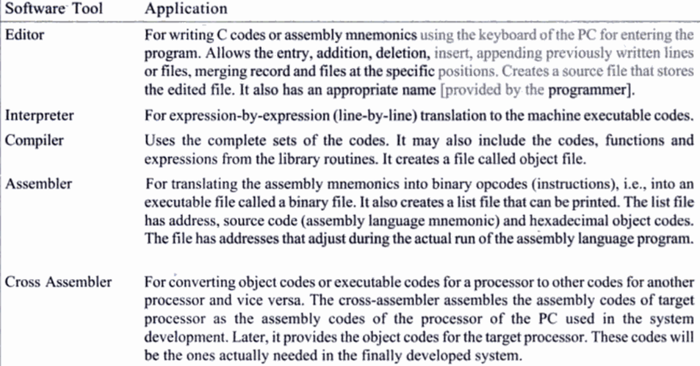
Embedded Hardware Units and Devices…..
8. Software Tools for Designing an ES:
Embedded Computing Platform Design
Dr. V.Vijayaraghavan, Assistant Professor-ECE, VFSTR, Guntur
Notes:
<number>
19/07/19
V.Vijayaraghavan, AP-ECE, AIT

Slide 46
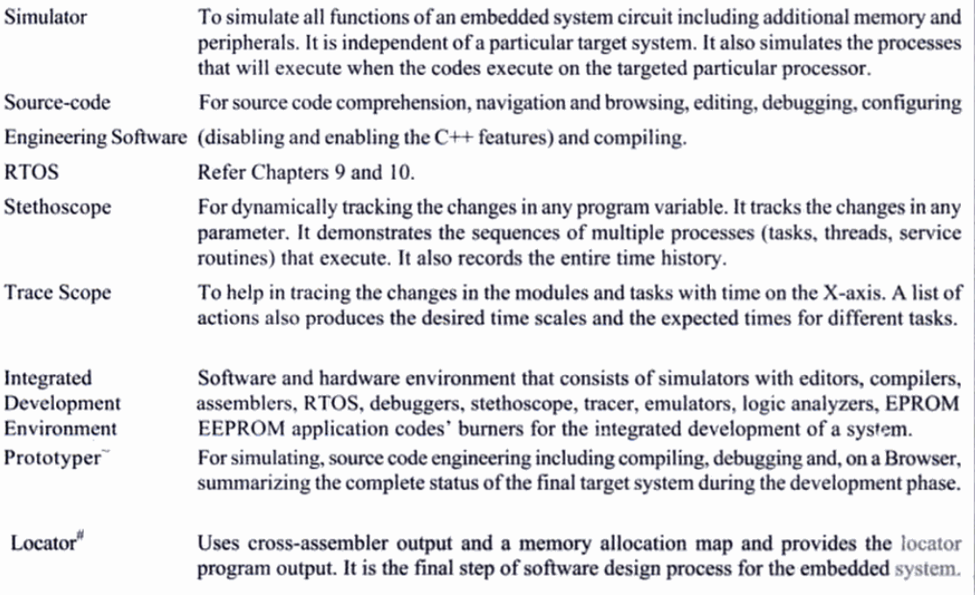
Embedded Hardware Units and Devices…..
8. Software Tools for Designing an ES……
Embedded Computing Platform Design
Dr. V.Vijayaraghavan, Assistant Professor-ECE, VFSTR, Guntur
Notes:
<number>
19/07/19
V.Vijayaraghavan, AP-ECE, AIT

Slide 47
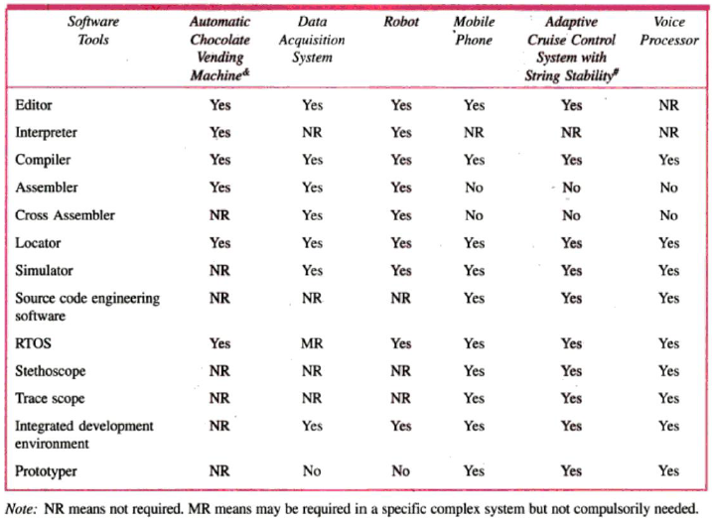
Embedded Hardware Units and Devices…..
9. Software Tools Required in Exemplary Cases:
Embedded Computing Platform Design
Dr. V.Vijayaraghavan, Assistant Professor-ECE, VFSTR, Guntur
Notes:
<number>
19/07/19
V.Vijayaraghavan, AP-ECE, AIT

Slide 48
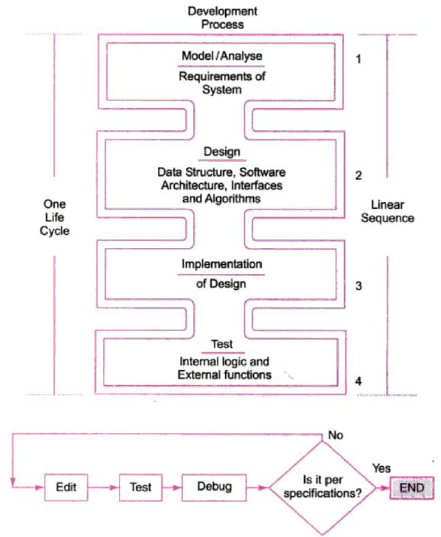
Design Process in ES:
Concepts used in design process:
Abstraction,
Hw/Sw architecture,
Extra functional properties,
System related family of design,
Modular design,
Mapping,
User Interface design,
Refinements
Dr. V.Vijayaraghavan, Assistant Professor-ECE, VFSTR, Guntur
Notes:
<number>
19/07/19
V.Vijayaraghavan, AP-ECE, AIT

Slide 49
UNIT – I INTRODUCTION TO EMBEDDED SYSTEMS
Embedded Computing Platform Design
Design Metrics in ES:
There are several design metrics for an embedded system.
Power Dissipation,
Performance,
Process deadlines,
User interfaces,
Size,
Cost,
Flexibility,
Prototype,
Development time,
Time to Market,
System and user safety,
Maintenance.
Dr. V.Vijayaraghavan, Assistant Professor-ECE, VFSTR, Guntur
Notes:
<number>
19/07/19
V.Vijayaraghavan, AP-ECE, AIT

Slide 50
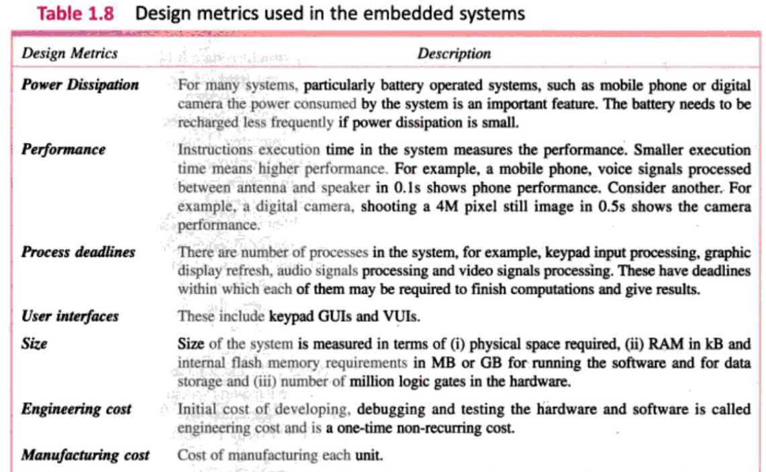
Design Metrics in ES…….
Embedded Computing Platform Design
Dr. V.Vijayaraghavan, Assistant Professor-ECE, VFSTR, Guntur
Notes:
<number>
19/07/19
V.Vijayaraghavan, AP-ECE, AIT

Slide 51
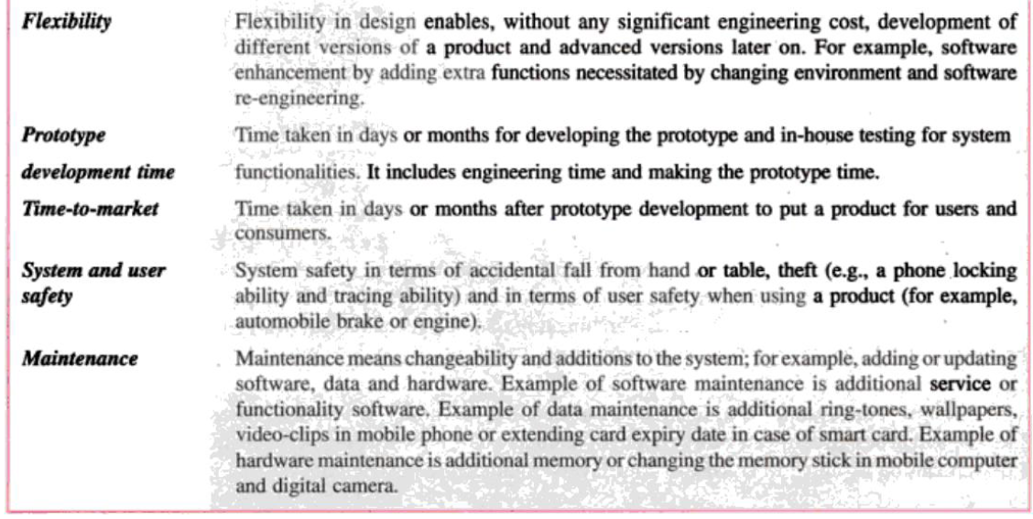
Design Metrics in ES…….
Embedded Computing Platform Design
Dr. V.Vijayaraghavan, Assistant Professor-ECE, VFSTR, Guntur
Notes:
<number>
19/07/19
V.Vijayaraghavan, AP-ECE, AIT

Slide 52
UNIT – I INTRODUCTION TO EMBEDDED SYSTEMS
Embedded Computing Platform Design
Challenges in ES design:
Challenges during the embedded system design process are
Amount and type of hardware needed,
Optimizing Power Dissipation and Consumption,
Process deadlines,
Flexibility and upgradability,
Reliability.
Dr. V.Vijayaraghavan, Assistant Professor-ECE, VFSTR, Guntur
Notes:
<number>
19/07/19
V.Vijayaraghavan, AP-ECE, AIT

Slide 53
Challenges in ES design……
Amount and type of hardware needed:
Optimizing the requirement of microprocessors, ASIPs and single purpose processors in the system.
Optimizing according to the performance, power dissipation, cost and other design metrics are the challenges in a system design.
A designer also chooses appropriate hardware based on the design metrics
Memory - RAM, ROM or internal and external flash or secondary memory,
Peripherals and devices,
Internal and external ports and busses,
Power source or battery
Dr. V.Vijayaraghavan, Assistant Professor-ECE, VFSTR, Guntur
Notes:
<number>
19/07/19
V.Vijayaraghavan, AP-ECE, AIT

Slide 54
Challenges in ES design……
Optimizing Power Dissipation and Consumption:
Power consumption during the operational and idle state of system should be optimal.
Following methods are used to meet the design challenges.
Clock rate reduction
Power dissipation reduces 0.25µW per 100kHz of reduced clock rate. (Reduce 8000kHz to 100kHz reduces 200µW power)
If clock rate is reduced, then the computation will take longer time.
By reducing the clock rate the advantages are
Power loss due to heat generation reduces,
RF interference also reduces.
Voltage reduction
Portable or hand held devices, compared to 5V operation a CMOS circuit power dissipation reduces by one sixth (~2V/5V)2 in 2.0V operation.
Thus the time needed for recharging the battery increase by a factor of 6.
Wait, stop and cache disable instruction
By using of 'Wait' and 'Stop' instructions and disabling or controlling certain units when not needed.
Caches-when not necessary and keep in disconnected state those structure units that are not needed during a particular software-portion execution, for example, display screen, timers or IO units.
Dr. V.Vijayaraghavan, Assistant Professor-ECE, VFSTR, Guntur
Notes:
<number>
19/07/19
V.Vijayaraghavan, AP-ECE, AIT

Slide 55
Challenges in ES design……
Process deadlines
Meeting the deadline of all processes in the system while keeping the memory, power dissipation, processor clock rate and cost at minimum is a challenge.
Flexibility and upgradability
Ability in design while keeping the cost minimum and without any significant engineering cost is a challenge.
Flexibility and upgradability allow different versions or advanced versions of a product to be introduced in the market later on.
Dr. V.Vijayaraghavan, Assistant Professor-ECE, VFSTR, Guntur
Notes:
<number>
19/07/19
V.Vijayaraghavan, AP-ECE, AIT

Slide 56
Challenges in ES design……
Reliability
Designing reliable product by appropriate design and thorough testing, verification and validation is a challenge.
Testing – to find errors and to validate that the implemented software is as per the specifications and requirements to get reliable product.
Verification – refers to an activity to ensure that specific functions are correctly implemented.
Validation – refers to an activity to ensure that the system that has been created is as per requirements agreed upon at the analysis phase, and to ensure its quality.
Dr. V.Vijayaraghavan, Assistant Professor-ECE, VFSTR, Guntur
Notes:
<number>
19/07/19
V.Vijayaraghavan, AP-ECE, AIT

Slide 57
UNIT – I INTRODUCTION TO EMBEDDED SYSTEMS
Embedded Computing Platform Design
Host and Target Machines:
Host:
A computer system on which all the programming tools run.
Where the embedded software is developed, compiled, tested, debugged, optimized, and prior to its translation into target device.
Host is generally a PC or laptop or workstation.
Target:
After writing the program, compiled, assembled and linked, then moved to target.
After development, code is cross-compiled, cross-assembled, linked into target processor instruction set and located into the target.
Target is a actual hardware for the embedded system under development.
Dr. V.Vijayaraghavan, Assistant Professor-ECE, VFSTR, Guntur
Notes:
<number>
19/07/19
V.Vijayaraghavan, AP-ECE, AIT

Slide 58
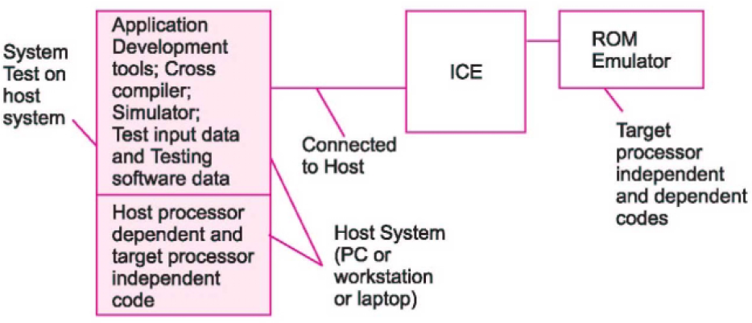
Host and Target Machines……
Code has two parts: hardware independent code and hardware dependent code.
Port and devices - have fixed addresses on hardware.
Embedded Computing Platform Design
Host and Target Test Systems During Development Process
Dr. V.Vijayaraghavan, Assistant Professor-ECE, VFSTR, Guntur
Notes:
<number>
19/07/19
V.Vijayaraghavan, AP-ECE, AIT

Slide 59
Host and Target Machines……
Host-Target System Development Approach:
During development process, a host system is used.
Then locating and burning the codes in the target board.
Target board hardware and software later copied to get the final embedded system.
Final system function exactly as the one tested and debugged and finalized during the development process.
Host system at PC or Workstation or Laptop:
High performance processor with caches,
Large RAM memory,
ROM BIOS (read only memory basic input-output system),
Very large memory on disk,
Keyboard, display monitor and mouse,
Network connection,
Program development kit for a high level language program or IDE,
Host processor compiler and cross compiler,
Cross assembler.
Embedded Computing Platform Design
Dr. V.Vijayaraghavan, Assistant Professor-ECE, VFSTR, Guntur
Notes:
<number>
19/07/19
V.Vijayaraghavan, AP-ECE, AIT

Slide 60
Host and Target Machines……
Target and Final systems:
Target system differs from a final system,
Target system interfaces with the computer as well works as a standalone system,
In target system might be repeated downloading of the codes during the development phase,
Target system copy made that later on functions as embedded system,
Designer later on simply copies it into final system or product,
Final system may employs ROM in place of flash, EEPROM or EPROM in embedded system,
Examples: Phillips LPC 21xx, ARM Powered STR710 System development boards.
Dr. V.Vijayaraghavan, Assistant Professor-ECE, VFSTR, Guntur
Notes:
<number>
19/07/19
V.Vijayaraghavan, AP-ECE, AIT

Slide 61
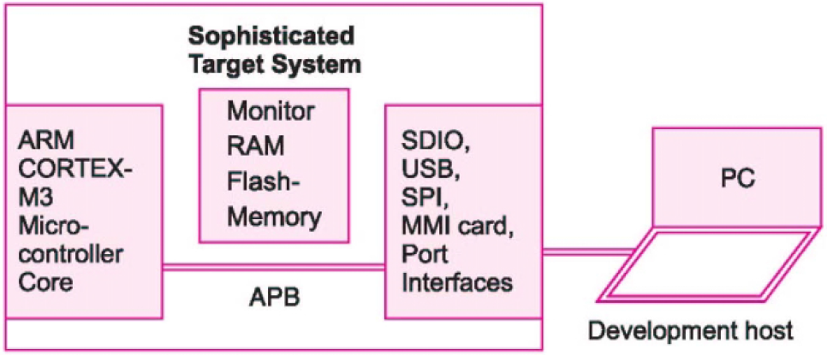
Host and Target Machines……
Target System Board
Sophisticated Target System
Dr. V.Vijayaraghavan, Assistant Professor-ECE, VFSTR, Guntur
Notes:
<number>
19/07/19
V.Vijayaraghavan, AP-ECE, AIT

Slide 62
Host and Target Machines…….
Embedded Computing Platform Design
Dr. V.Vijayaraghavan, Assistant Professor-ECE, VFSTR, Guntur
Notes:
<number>
19/07/19
V.Vijayaraghavan, AP-ECE, AIT

Slide 63
Host and Target Machines……
Testing Steps at Host Machine:
Initial Tests - each module or segment at initial stage itself and on host itself.
Test data - all possible combinations of data designed and taken as test data.
Exception condition tests - all possible exceptions for the test.
Tests-1: hardware independent code.
Tests-2: scaffold software, software running on host the target dependent codes and which have same start of code and port and device addresses as at the hardware.
Instructions - given from file or keyboard inputs.
Outputs - at host’s LCD display and saves at file.
Test Interrupt Service routines hardware independent part - sections of interrupt service routines are called, which are hardware independent and tested.
Test Interrupt Service routines hardware dependent part.
Timer tests - Hardware dependent code timing functions, clock tick set, counts get, counts put, delay.
Assert-Macro tests - insert the codes in the program that check whether a condition or a parameter actually turns true or false.
If it turns false - the program stops.
Use the assert macro at different critical places in the application program
Embedded Computing Platform Design
Dr. V.Vijayaraghavan, Assistant Professor-ECE, VFSTR, Guntur
Notes:
<number>
19/07/19
V.Vijayaraghavan, AP-ECE, AIT

Slide 64
UNIT – I INTRODUCTION TO EMBEDDED SYSTEMS
Getting ES in to Target System:
Getting Embedded Software into the Target System using Device Programmer.
Device PROM or Flash Programmer
also called laboratory programmer
A programming system for a device
Device selectable
Device may be a PROM or EPROM chip or a flash or a unit in a microcontroller or PLA, GAL or PLC.
Selected device inserts into a socket
Programmed (burned the codes) by transfer of the bytes for each address using the software at the host
Dr. V.Vijayaraghavan, Assistant Professor-ECE, VFSTR, Guntur
Notes:
<number>
19/07/19
V.Vijayaraghavan, AP-ECE, AIT

Slide 65
Getting ES in to Target System:
Dr. V.Vijayaraghavan, Assistant Professor-ECE, VFSTR, Guntur
Notes:
<number>
19/07/19
V.Vijayaraghavan, AP-ECE, AIT

Slide 66
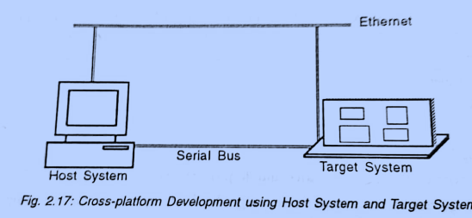
UNIT – I ARCHITECTURE OF EMBEDDED SYSTEMS…..
Process of Generating Executable Images:
Procedure for creating and executing the application software is as follows
Create the source file, Create the executable file
Give the command for execution, The process is loaded into the RAM by loader
Loader transfers the control to the process and the process executes.
Embedded Computing Platform Design
V.Vijayaraghavan, Assistant Professor-ECE, VFSTR, Guntur
Notes:
<number>
19/07/19
V.Vijayaraghavan, AP-ECE, AIT

Slide 67
Embedded Computing Platform Design
UNIT – I ARCHITECTURE OF EMBEDDED SYSTEMS…..
Process of Generating Executable Images…
Cross Platform Development
Some times the host computer used for the development of application software may not be used to debug or compile the software. Then another system which contains all the of running development tools (editors, compilers, assemblers, debuggers etc.) may be used.
This type of choosing another host system, other than the original host system is known as Cross platform development. Some common differences between host and target machines are different operating system, different system boards or a different CPU. A cross platform development environment allows you to maximize the use of all your resources.
V.Vijayaraghavan, Assistant Professor-ECE, VFSTR, Guntur
Notes:
<number>
19/07/19
V.Vijayaraghavan, AP-ECE, AIT

Slide 68
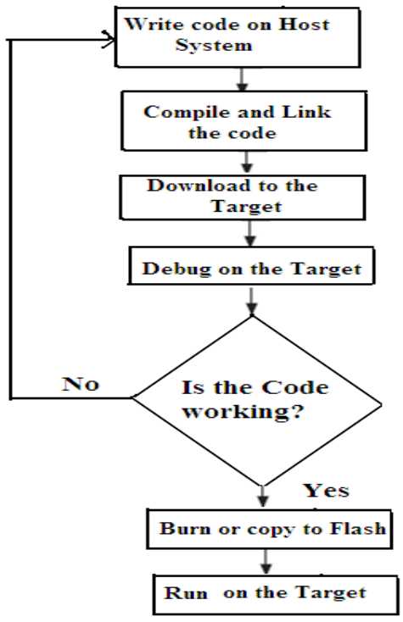
Embedded Computing Platform Design
UNIT – I ARCHITECTURE OF EMBEDDED SYSTEMS…..
Process of Generating Executable Images…..
Cross Platform Development…
Here host machine is the machine on which you write and compile programs. A target machine may be another general-purpose computer, a special-purpose device employing a single-board computer or any other intelligent device.
Debugging is an important issue in cross-platform development. Since you are usually not able to execute the binary files on the host machine, they must be run on the target machine.
V.Vijayaraghavan, Assistant Professor-ECE, VFSTR, Guntur
Notes:
<number>
19/07/19
V.Vijayaraghavan, AP-ECE, AIT

Slide 69
Embedded Computing Platform Design
UNIT – I ARCHITECTURE OF EMBEDDED SYSTEMS…..
Process of Generating Executable Images…..
Cross Platform Development…
Cross compilation tools are very important for successful product development. Selection of these tools should be made based upon the embedded system itself as well as features to test and debug software remotely.
The necessary tools for the cross platform development are
Cross-compiler
Cross-assembler
Cross-linker
Cross-debugger
Cross-compiled libraries.
These components will enable to compile, link and debug code for the target environment through the cross-compilation environment.
V.Vijayaraghavan, Assistant Professor-ECE, VFSTR, Guntur
Notes:
<number>
19/07/19
V.Vijayaraghavan, AP-ECE, AIT

Slide 70
REFERENCE BOOKS
Raj Kamal, “Embedded Systems”, 2nd Edition, Pearson, 2009.
K.V.K.K. Prasad, “Embedded Real-Time Systems: Concepts, Design & Programming”, Dream Tech Press, 2005.
Marilyn Wolf, “Computers as Components - Principles of Embedded Computing System Design”, Third Edition, Morgan Kaufmann Publisher-Elsevier, 2012.
Raj Kamal, “Microcontroller, Programming and Design”, 2nd Edition, Pearson, 2012.
Andrew N Sloss, Dominic Symes and Chris Wright, “ARM system developers guide”, Morgan Kaufmann Publisher-Elsevier, 2008.
Michael J Pont, “Embedded C”, Pearson Education, 2007.
Steve Furber, “ARM System on Chip Architecture”, Addison Wesley, 2nd ed., 2000.
Wang K.C., Embedded and Real-Time Operating Systems, Springer, 2017.
Frank Vahid and Tony Givargis, Embedded System Design: A Unified Hardware/Software Introduction, John Wiley & Sons, Student edition, 2006.
V.Vijayaraghavan, Assistant Professor-ECE, VFSTR, Guntur
Notes:
<number>

Slide 71


Thank You
Dr. V.Vijayaraghavan, Assistant Professor-ECE, VFSTR, Guntur

